Slide 1

$ cat title.txt
How Type-Driven Development Can Turbocharge your Contract's Security
Brought to you by @philogy

Slide 2


$ whoami
Philippe Dumonet
aka Philogy
~5 years experience working with smart contracts
Programming Language R&D
Lead Security Researcher @ Spearbit
Lead Smart Contract Engineer @ Sorella
Notes:
gas golfing with solidity
Senior auditor at Quantstamp in 2022
freelanced as a smart contract developer working on DeFi protocols (1Hive, delegatexyz, Blueberry finance, Enso)

Slide 3
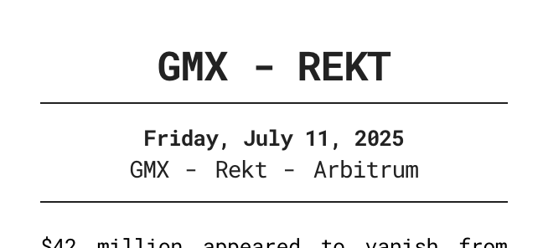
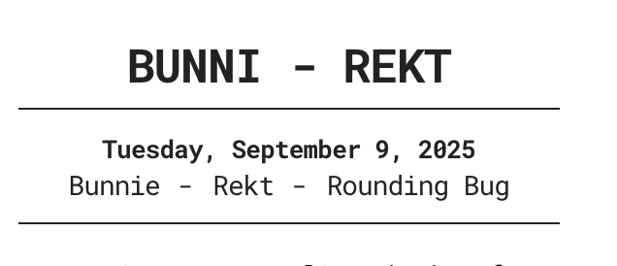
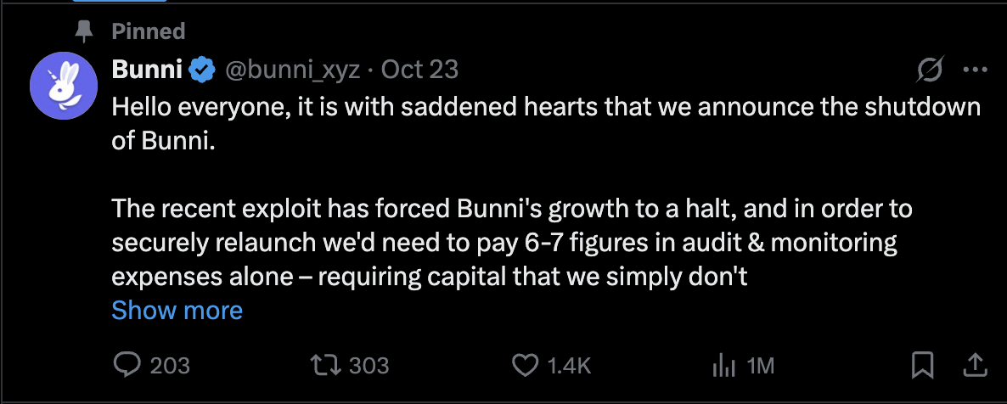
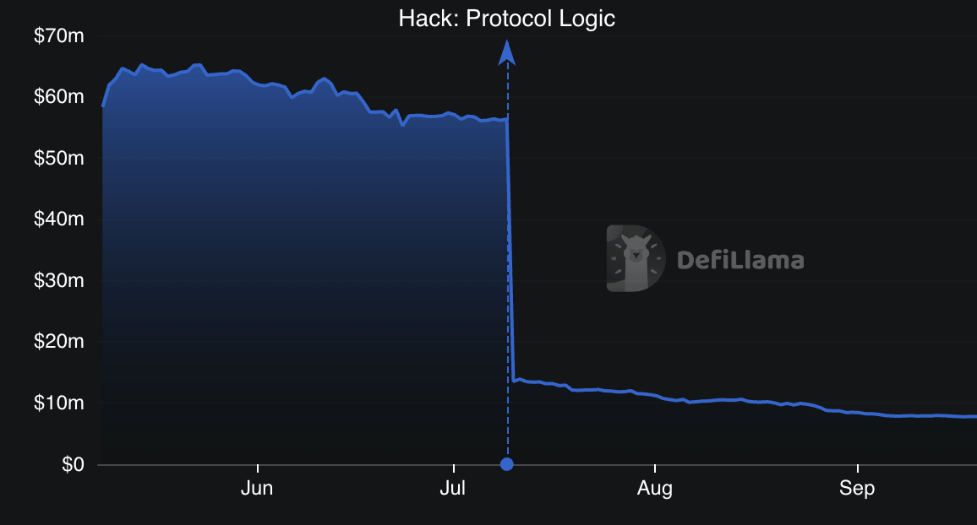
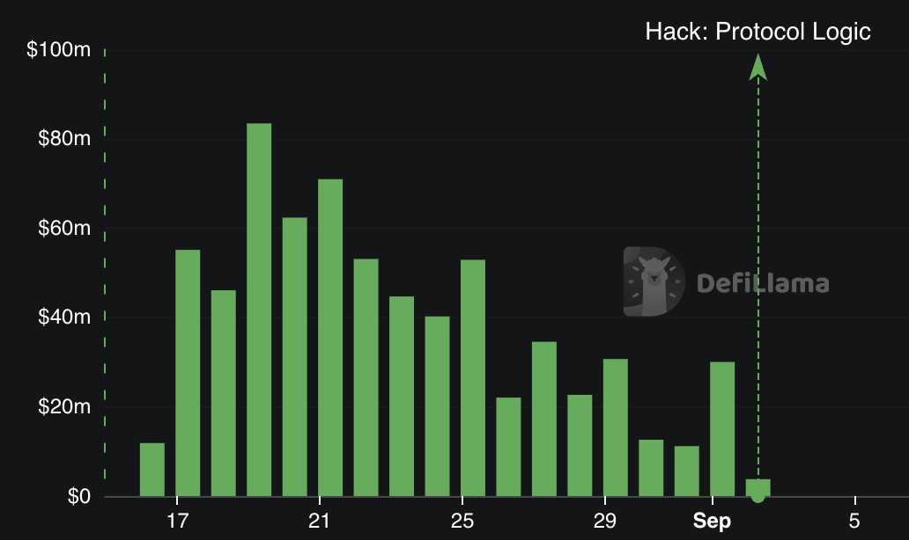
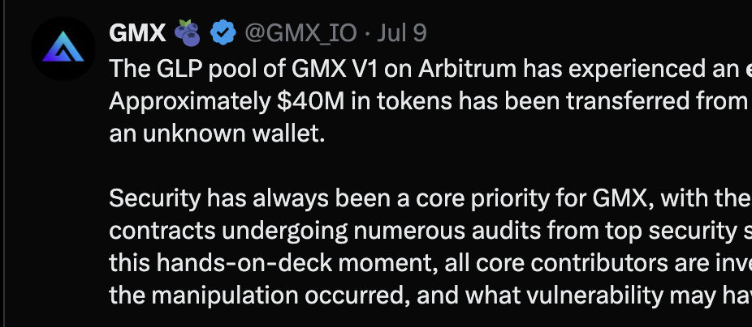
$ cat intro-1.txt
The Bar is High: Write Bug-Free Code or Die
... and dozens more
Notes:
Remind audience about why security matters
Teams shutdown despite being skilled & well founded because of smart contract bugs
Probably one of the largest DeFi business risks after finding PMF

Slide 4
$ cat intro-2.txt
Security = Resources * Productivity
Notes:
Our goal is to write perfect code but the reality is deadlines, product launches and last minute crunches
Our real end-security is dependent on our available resources and how efficiently we utilize them to develop & validate code
Under this model, things one might not immediately expect to translate into better/worse security actually have a great impact:
Developer Productivity (compile times, test times, ability to more easily interface tests with contracts) => better security
Detecting and preventing small bugs that would’ve been caught later by testing/audits anyway => better security
Static analysis tool that reveals bugs but has high positive rate (e.g. slither back in the day) => potentially worse security
Type driven development => way to catch simple bugs earlier, core principle: the compiler’s type system can be leveraged as an easy to use powerful static analysis tool

Slide 5
$ tdd --help
What is Type Driven Development (TDD)?
📝 Types as Documentation
🔍 Types as Cheap Static Analysis
🔧 Design through Types
Notes:
what are the key principles of type driven development

Slide 6
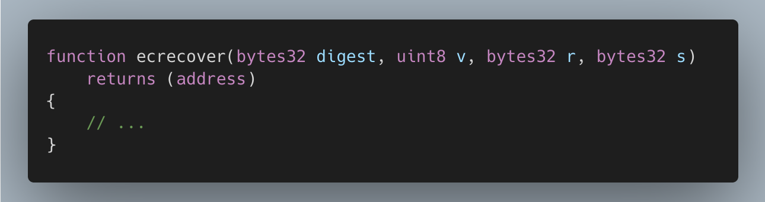
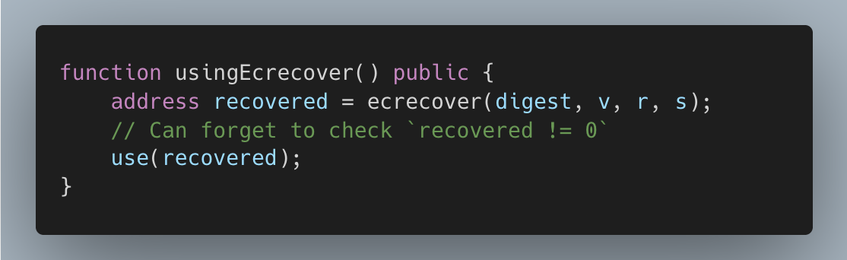
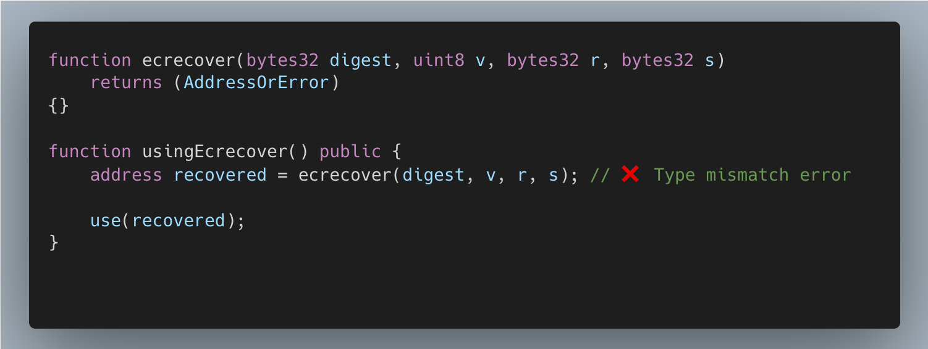
$ man ecrecover
Case Study I: ecrecover
⚠️ have to remember address(0) means failure
⚠️ no clear difference between checked & unchecked state
💡Solution: Introduce a type to make difference clear

Slide 7
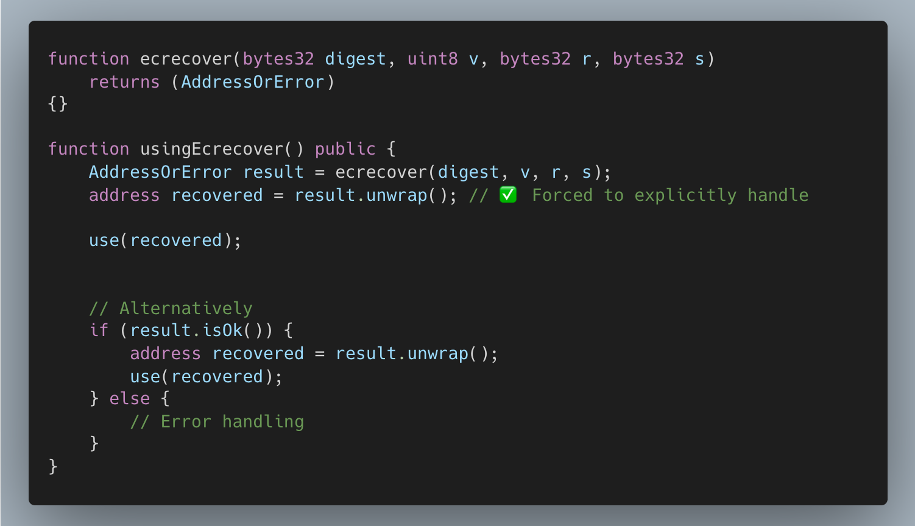
$ man ecrecover
Case Study I: ecrecover
✅ custom return type documents possible failure
✅ statically checks that error was handled
✅ removes cognitive burden of remembering edge case
AddressOrError
address
error

Slide 8
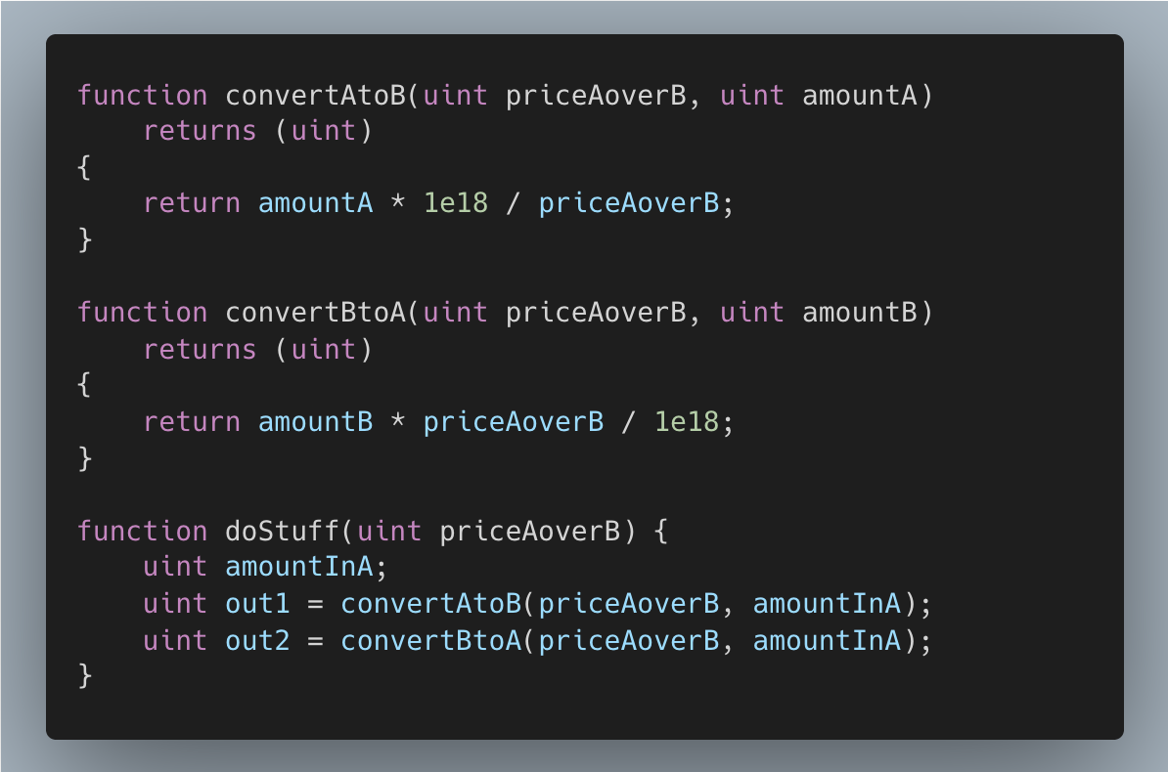
$ man unit-math
Case Study II: math with units
⚠️ API has footguns (can mix units incorrectly)
⚠️ Documented via parameter names
⚠️ Correct usage imposes high cognitive burden
Notes:
even in this example code is clearer than it usually would be because of the longer & explicit names

Slide 9
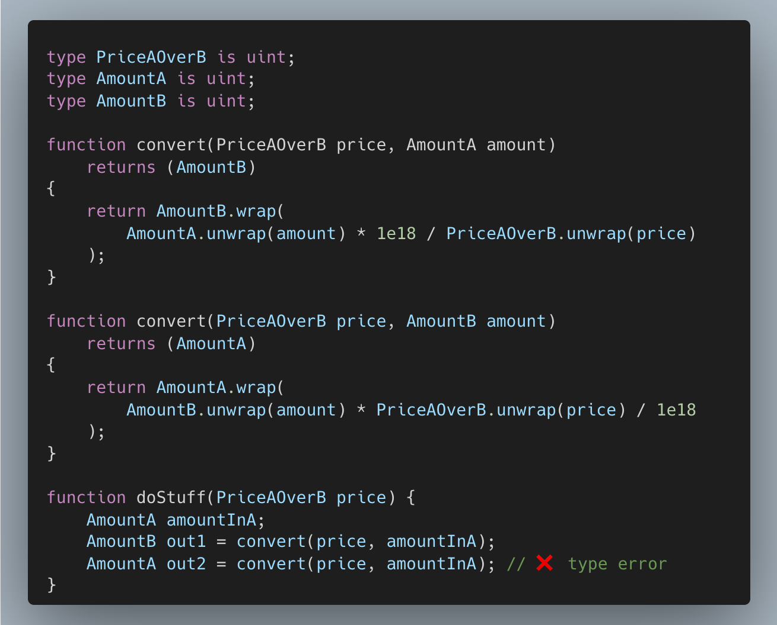
$ man unit-math
Case Study II: math with units
💡 Solution: specialize uint256 using custom types
✅ compiler now statically checks correct usage
✅ correct function automatically chosen based on types

Slide 10
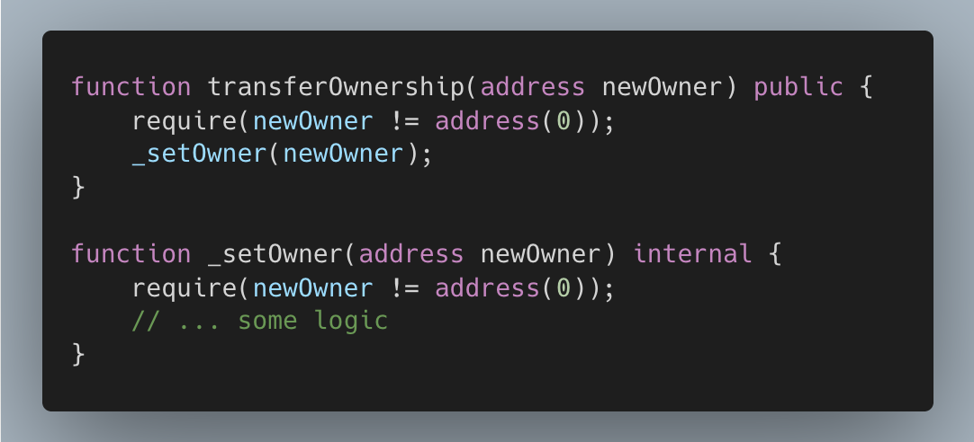
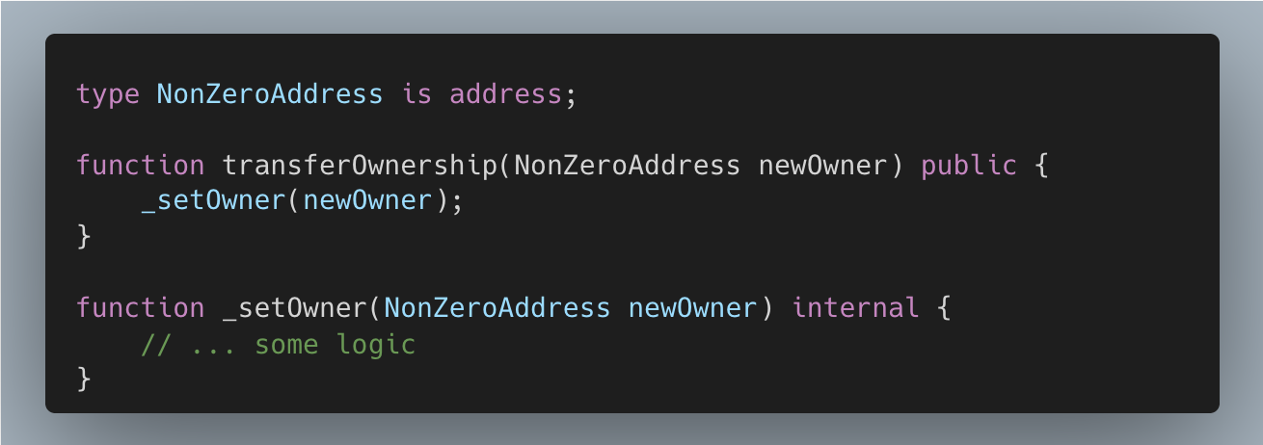
$ man transfer-ownership
Case Study III: transferOwnership
⚠️ Input requirements not clear from definition
⚠️ Duplication of verification logic “just in case”
💡 Solution: Signal intent with types

Slide 11
$ tdd --help
✨ documenting subtle requirements in
comments
When to apply Type Driven Development
(TDD)

Slide 12
$ tdd --help
✨ documenting subtle requirements in
comments
✨ want to ensure caller doesn’t forget to
handle certain states/values
When to apply Type Driven Development
(TDD)

Slide 13
$ tdd --help
✨ documenting subtle requirements in
comments
✨ want to ensure caller doesn’t forget to
handle certain states/values
✨ using base types for similar but distinct
concepts such as different units
When to apply Type Driven Development
(TDD)

Slide 14

“
... Btw, did you spot the problem in one of the examples?

Slide 15
…let’s take a closer look 👀
can you see it now?
“
❌ Solidity sees “NonZeroAddress” as an alias for “address” for purposes of ABI encoding/decoding

Slide 16
…let’s take a closer look 👀
“
❌ Solidity sees “NonZeroAddress” as an alias for “address” for purposes of ABI encoding/decoding
❌ Will not validate our invariant that “x != 0”

Slide 17
…let’s take a closer look 👀
“
❌ Solidity sees “NonZeroAddress” as an alias for “address” for purposes of ABI encoding/decoding
❌ Will not validate our invariant that “x != 0”
❌ Will decode & instantiate “address(0)” as a “NonZeroAddress” without errors

Slide 18
$ solc tdd.sol 2>&1
❌ Users can override encapsulation
❌ Compiler will directly instantiate types
❌ Structs not zero-cost
❌ Repetitive boilerplate
❌ No standard library
Solidity TDD Pitfalls
Notes:
As a best practice: never manually instantiate outside of defining file
Best practice 2: don’t put custom types/structs with special invariants in public interfaces/abi.decode output
Raw memory managing types can violate compiler invariants
structs always dynamically allocated in memory
simple functions may or may not be inlined
boilerplate: no generics, redefine custom operators, using syntax
for convenient in-place mutation style syntax => need pointer indirection

Slide 19
“
Most of these issues are language level issues
To fix these we need to change the language, or just build our own

Slide 20
$ sensei
Introducing: Sensei
Helping good devs write better EVM contracts
Notes:
Plan:
how do we fix this => need to improve the core language
no matter how much you abstract if abstractions are fundamentally porous the final result is porous
can partially address issues with 3rd party tools (foundry style pre-processing, static analysis) => problem is not everyone runs these
Pretty easy to fix at the language level:
Introduce generalized encapsulation like nearly every other language
more consistent inlining
default structs to stack
have generics
Problem: Solidity moves very slowly
This is why I’m building Sensei, Vyper & Solidity are slow to ship major language features => need a fresh start to move quickly, core solidity has similar ideas but ??? on their timeline, building a new language is also easier than most people think.
Features to make it better:
Generalize encapsulation, any custom type should be able to make its state private to enforce its own invariants
Put structs & custom types on the stack by default to reduce gas overhead
Implement basic compiler optimizations for memory & inlining
Generics to reduce boilerplate
Standard library that leverages TDD for the basic stuff out of the box already
Scan this QR code to join the private beta

Slide 21
$ sensei goals
Day 1 Goals
⚡️
🧱
🔨
Fast Compile Times
Goal: 500ms worst case debug build
Standard Library
ABI, EIP712, TDD, ERC20, ERC721, etc.
Editor Support
LSP with autocomplete & go-to-definition

Slide 22
$ sensei docs/tdd
TDD-Focused Upgrades
💊
⚜️
📊
Encapsulation
Private/public methods, functions & attributes
Generics
Make any code reusable with minimal boilerplate
Gas Optimization
Stronger inlining, structs members on stack

Slide 23


$ evm
Why do we need a new language?
++
Solidity
large backlog of existing issues
team conservative about changes
legacy codebase
Vyper
simplicity maximalism
building IR alone
not prioritizing key dev needs (storage packing, dyn. memory)
Core Solidity
complex type system
split solc focus
unclear how to contribute
Competition + I think it’d be Fun

Slide 24

$ sensei join
(insert FOMO title to get you to scan)
Closed Beta Begins:
Q1 2026

Slide 25



18 NOV 2025
Q&A
philogy
philogy
philogy.21
Notes:
I’ll share a link to the slides on twitter for anyone who wants them

